Slide 1
CS2040 Lab10 B03 (Please set up your camera for Visualgo quiz) 02/11/2020

Slide 2
Mock PE and PE

Slide 3
Magical List
O(n) per op
O(1) per op, except get idx
O(1) per op
[8 7 6 5 4 3 2]
+ - + - + - +
+
-
idx 3?
+
-
==

Slide 4
Counting
Count the number of continuous subarrays that has the sum of its elements greater than or equal
to k.
sum >= 6
[4 3 2 1 0 0 2 4] elms
0 4 7 9 10 10 10 12 16 prefixes
Cubic Quadratic nlogn Linear

Slide 5
Supermart
1 : [3 4 1] 3
2 : [] 0
3 : [9 3] 2
…
n-1: [] 0
n : [3] 1
-min
+min
Per op:
O(n log n + q)
O(n log n)
O(n log n), except O(log n) +min
O(log n +) per op - amortized
O(log n) per op
-q3

Slide 6
Visualgo quiz

Slide 7
Visualgo quiz
15 questions in 10 minutes
The meeting will be recorded during quiz.
Make sure you record the whole screen including the timestamp
Upload your recording to TG group immediately after the quiz (don’t edit your message if you upload a wrong video, just send another message to upload),
and name your video as NAME+MATRIC NUMBER+ SCORE
https://visualgo.net/training?diff=Hard&n=15&tl=10&module=graphds+dfsbfs

Slide 8
CS2040 Lab09
Q1 Trip

Slide 9
Question
Check whether there exists a path from S (source) to T (destination) where the interest values are strictly increasing.

Slide 10
Input & Output
The first line contains four integers n, m, S, T – the number of cities n, number of roads connecting those cities m, the starting city S and the destination T.
The second line contains n integers, the interesting values of the cities.
In the next m lines, each consists two integers x, y – represents a bi-directional road connecting city x and city y.
Output “YES” is there exists such a path, and “NO” otherwise.

Slide 11
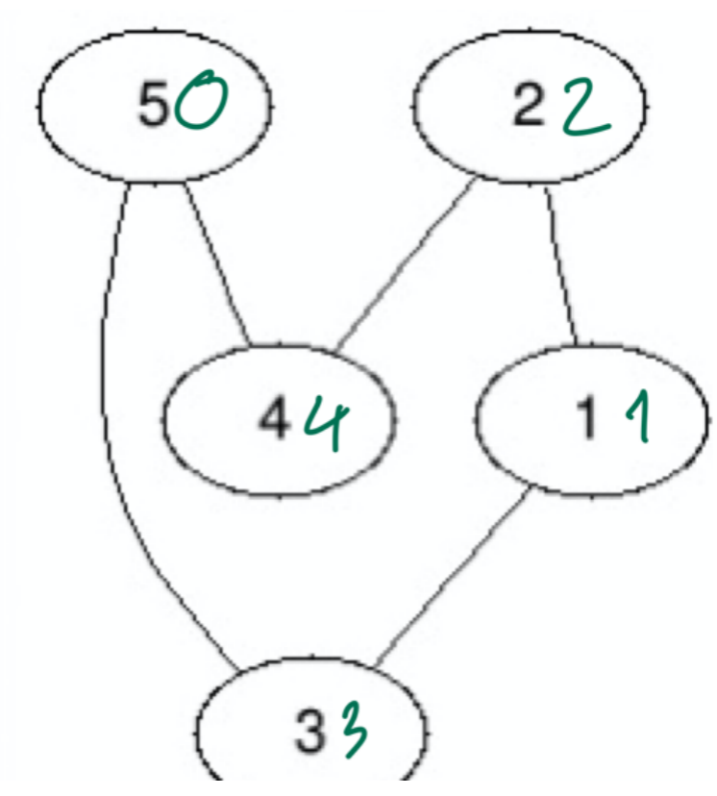
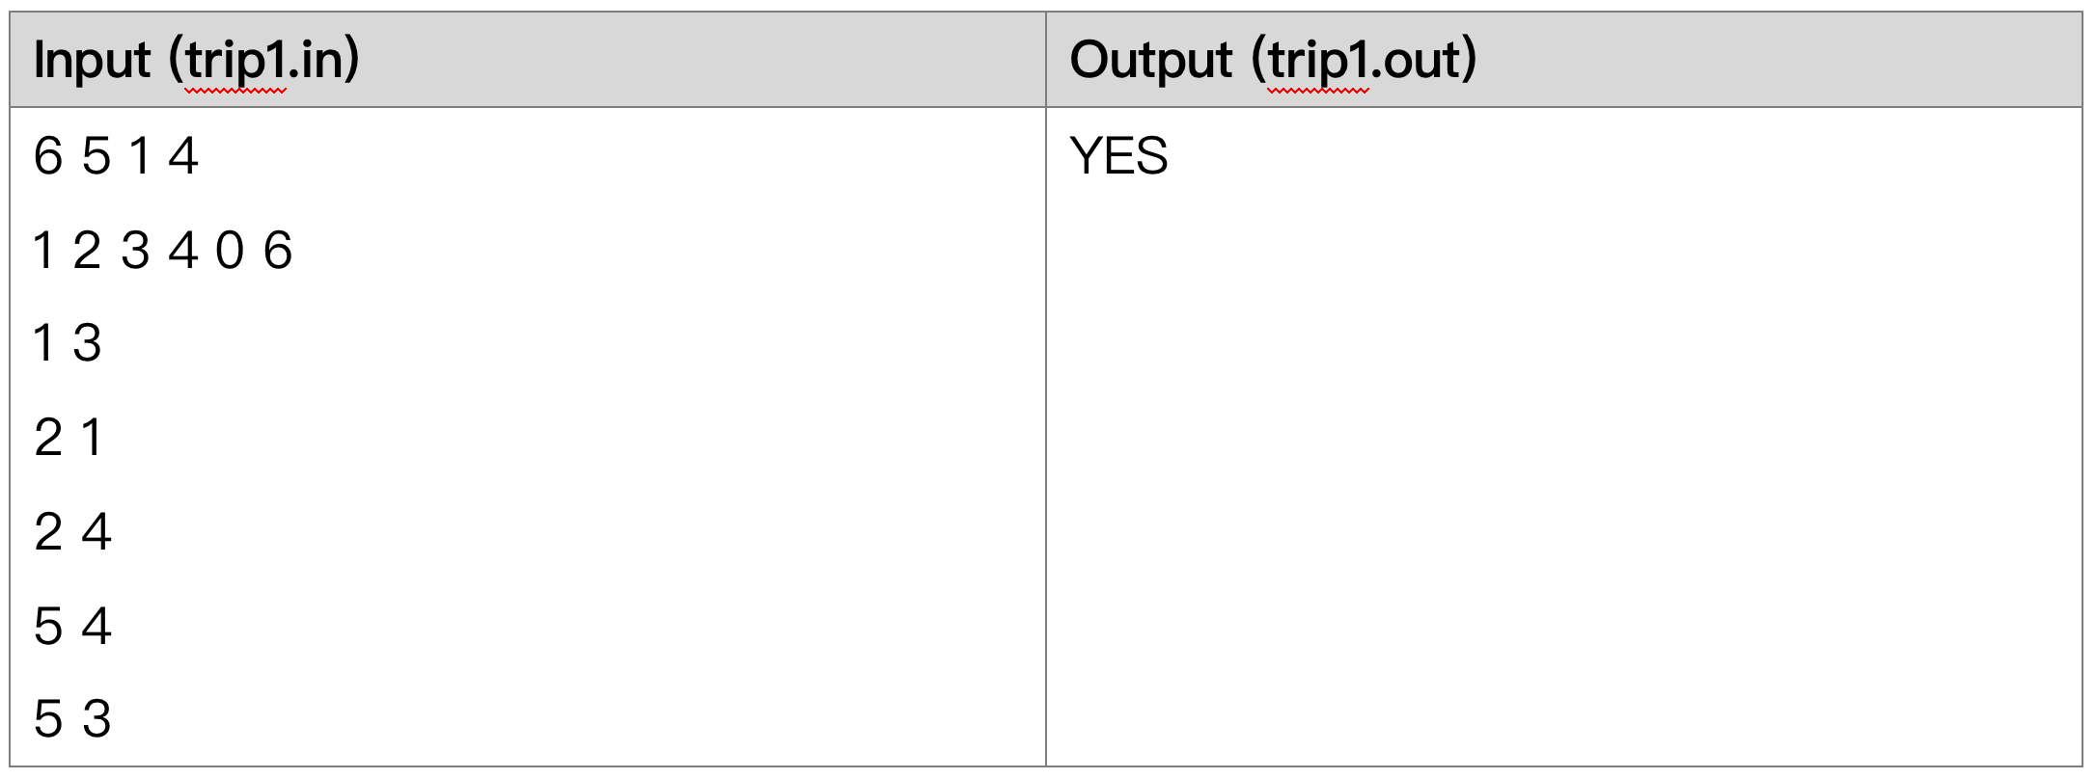
Example
(The green number is the interesting value of each vertex)
We need to travel from 1 to 4. One of the possible path is 1 - 2 - 4. There exists another path from 1 to 4 is but this path does not satisfy the requirement since the interesting value of vertex 5 (0) is not strictly larger than the value of vertex 3 (3).

Slide 12
Idea
Because we only want paths that consist of edges of increasing values, we may only keep single-directional edges that point from lower-value cities to higher-value ones.
For example, if an edge exists between x(5) and y(8), we only record x-y, while discarding y-x.
In this way, we can traverse the graph without worrying about taking invalid edges.
Graph traversal: BFS? DFS?

Slide 13
Covid
Problem 2

Slide 14
Summary
Given n people, m pairs of people will meet every weekend.
There exists the disease Covid-19. Every time a person is caught with this disease, he/she will only start to transmit it in the following week to whoever he/she meets.
At week 0, k people caught Covid-19. The weekly meetings will start from week 1.
Find the earliest time where everyone caught Covid-19 or print out “Some are safe” if there are some people that will never be infected.

Slide 15
Graph traversal
Spreading of disease to people who met
Find out how many weeks it takes to spread to everyone
BFS or DFS ?

Slide 16
Approach
BFS from the initial k infected people
Ignore the visited (infected) nodes.
Keep track of which week a node is first visited (infected).
Finally, find out if there are any nodes which are not visited or return the max number of weeks required to visit a node.

Slide 17
Height
Problem 3

Slide 18
Problem Statement:
Number of Input, N: 0 <= N <= 10^5
Each input would contain 3 integers: Ai, Bi, Hi
(1<= Ai,Bi <= N, Ai =/= Bi) (0 <= Hi <= 10^6)
Q: 0 <= N <= 10^5
Xi, Yi : 1 <= Xi, Yi <= N

Slide 19
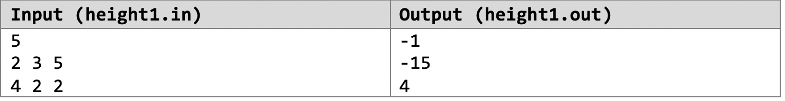
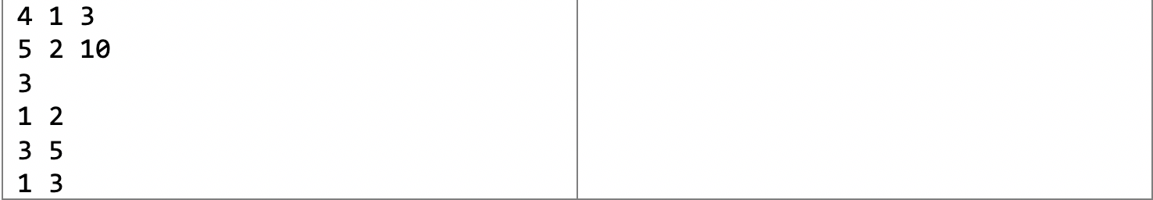
Example

Slide 20
Things to note:
It is guaranteed that the relative heights of all pairs of areas can be computed from the data provided in the input.
In the event that area is lower than area , please output a negative number.

Slide 21
Explanation:
Area 1 is 3 centimeters above Area 4 while Area 2 is 2 centimeters above Area 4.
Hence, Area 2 is 1 centimeters below Area 1.
Area 2 is 10 centimeters above Area 5.
Area 3 is 5 centimeters above Area 2 and hence 15 centimeters above Area 5.
As such, Area 5 is 15 centimeters below Area 3.
From the first query, Area 2 is 1 centimeters below Area 1.
Area 3 is 5 centimeters above Area 2.
As such, Area 3 is 4 centimeters above Area 1.

Slide 22
Data Structure and logic
Edge List? Adjacency Matrix? Adjacency Lists?
How do you get the height differences?
DFS? BFS?

